Slide 1
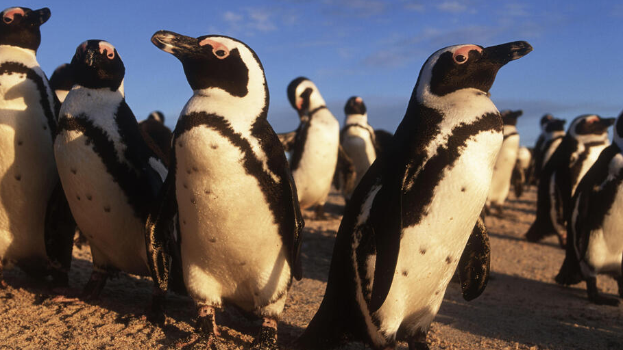
“How to keep predators, particularly honey badgers, away from the fence and the penguins??”
Group 31

Slide 2
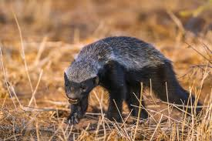

INSIGHT FROM THE LITERATURE
1. The world’s most fearless animal
2. Courageous, aggressive, strong and
SMART!!
Weaknesses:
Nocturnal
Heavily rely on smell for hunting
Repelled by certain scents e.g Citronella oil, garlic, vinegar etc

Slide 3
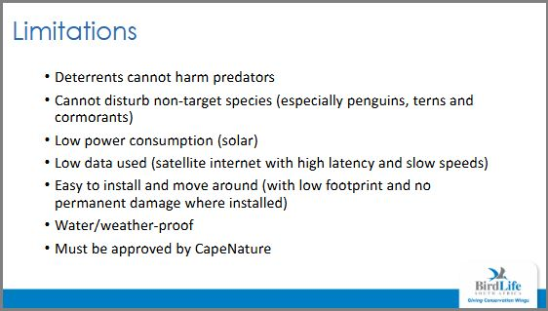
Proposed solution: Honey Badger Repellent System
Light and scent as a repellent
Periodically spray the vicinity to desensitize the colony
Once animal detected – turn on the strobing lights and power the spray

Slide 4
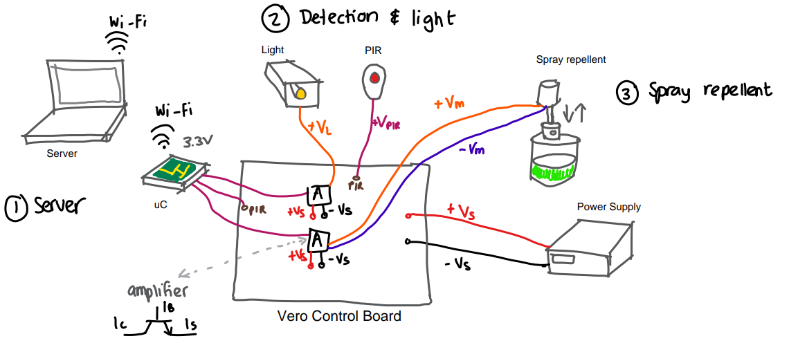
Overview
Overview of System

Slide 5
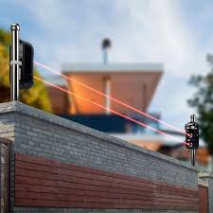
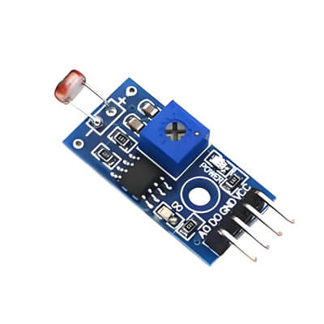
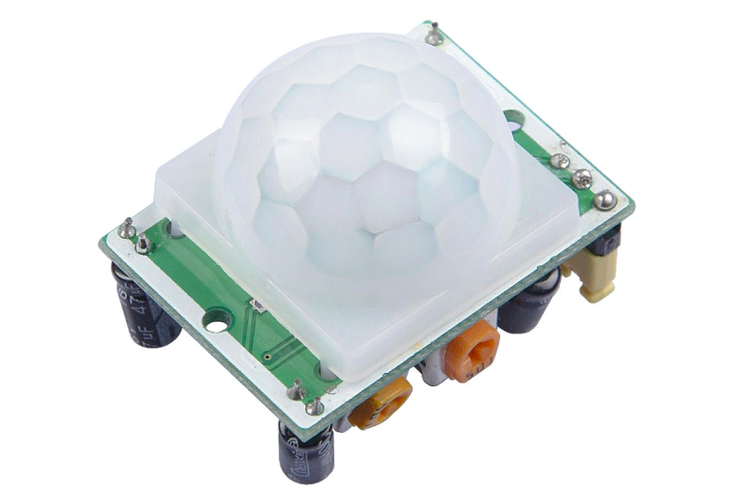
Animal Detection Subsystem
Light sensor
*Power efficiency
*Increases electronics’ lifespan
Passive Infrared (PIR)
*Common use in literature
*Long-range detection
IR Break beam sensor
* Short-range detection
Sequential logic of operation:
Light sensor
PIR sensor
IR Break beam
ANIMAL DETECTED!!

Slide 6
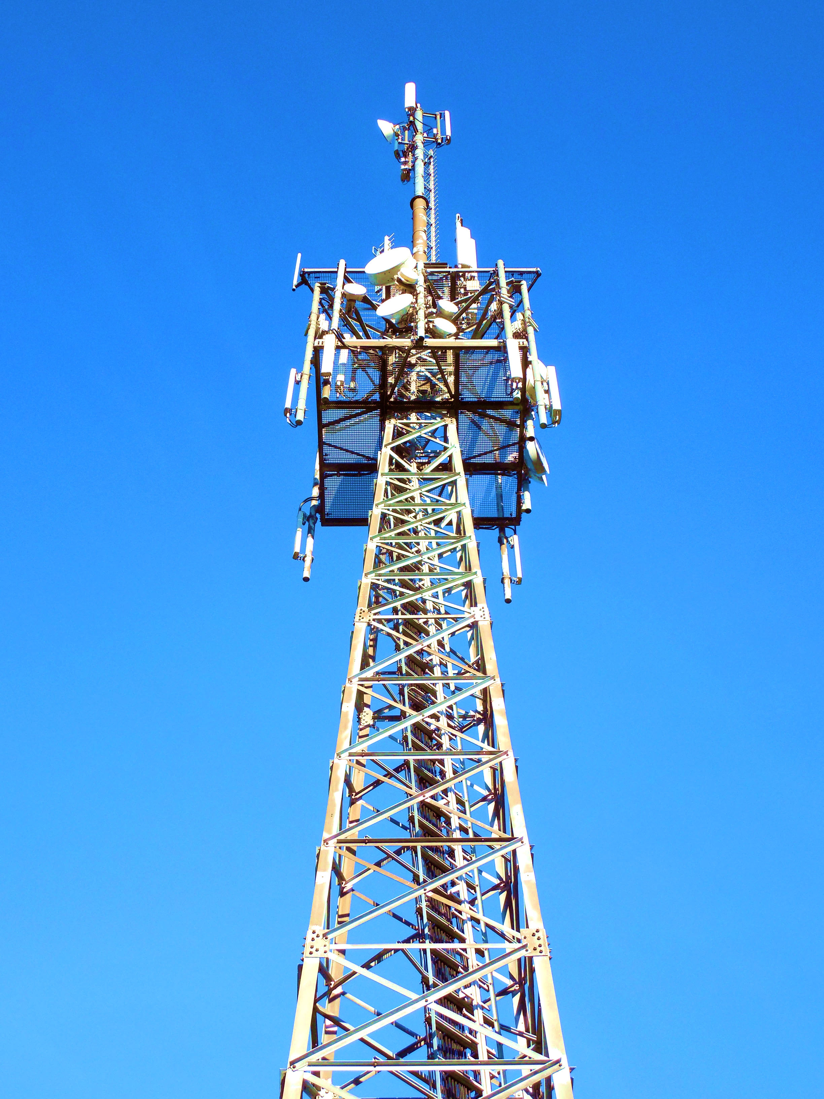
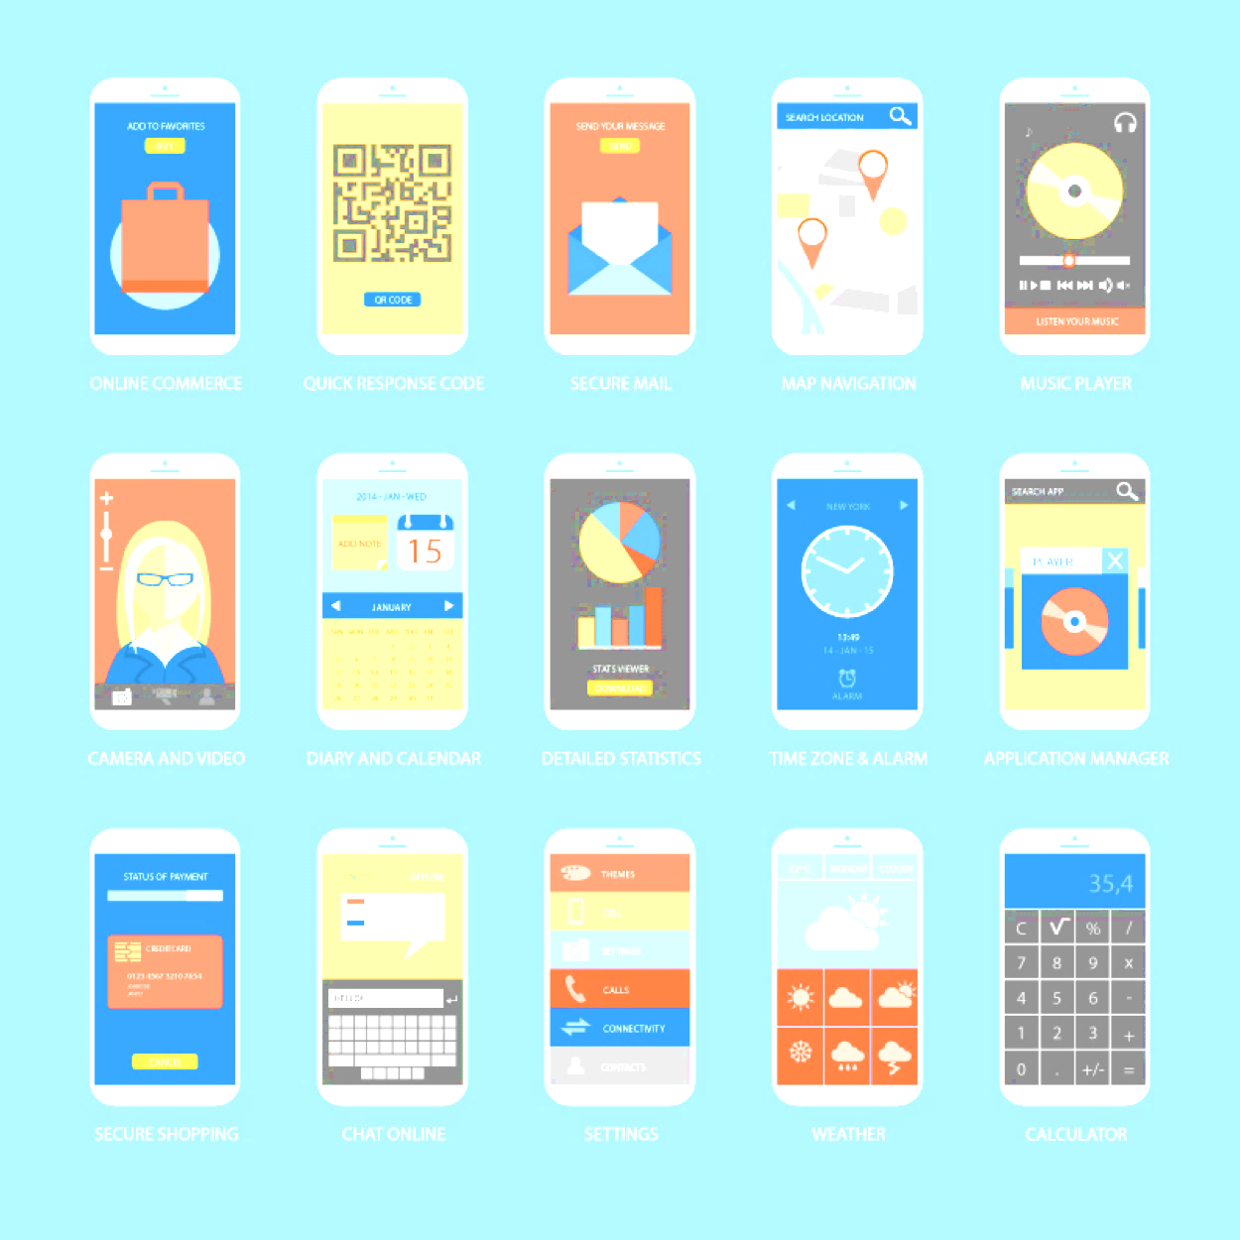
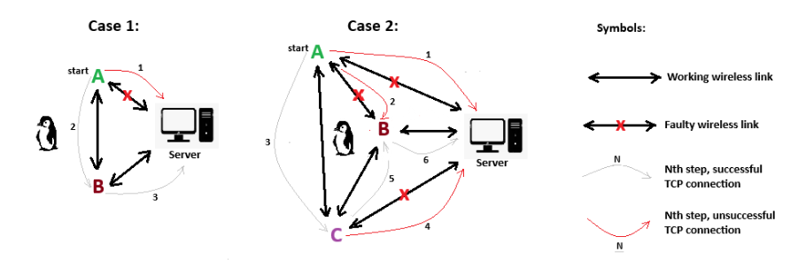
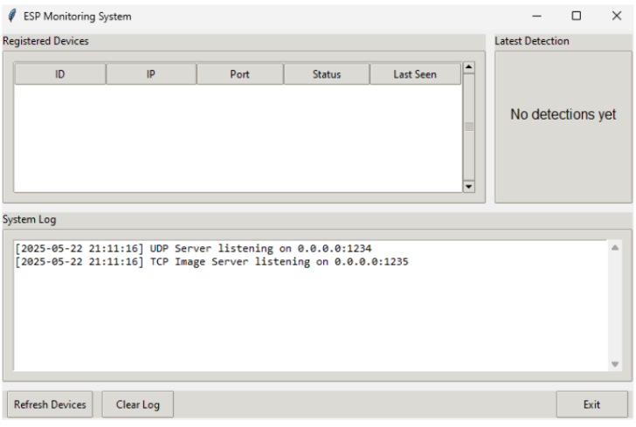
Networking and User Interface Subsystem

Slide 7
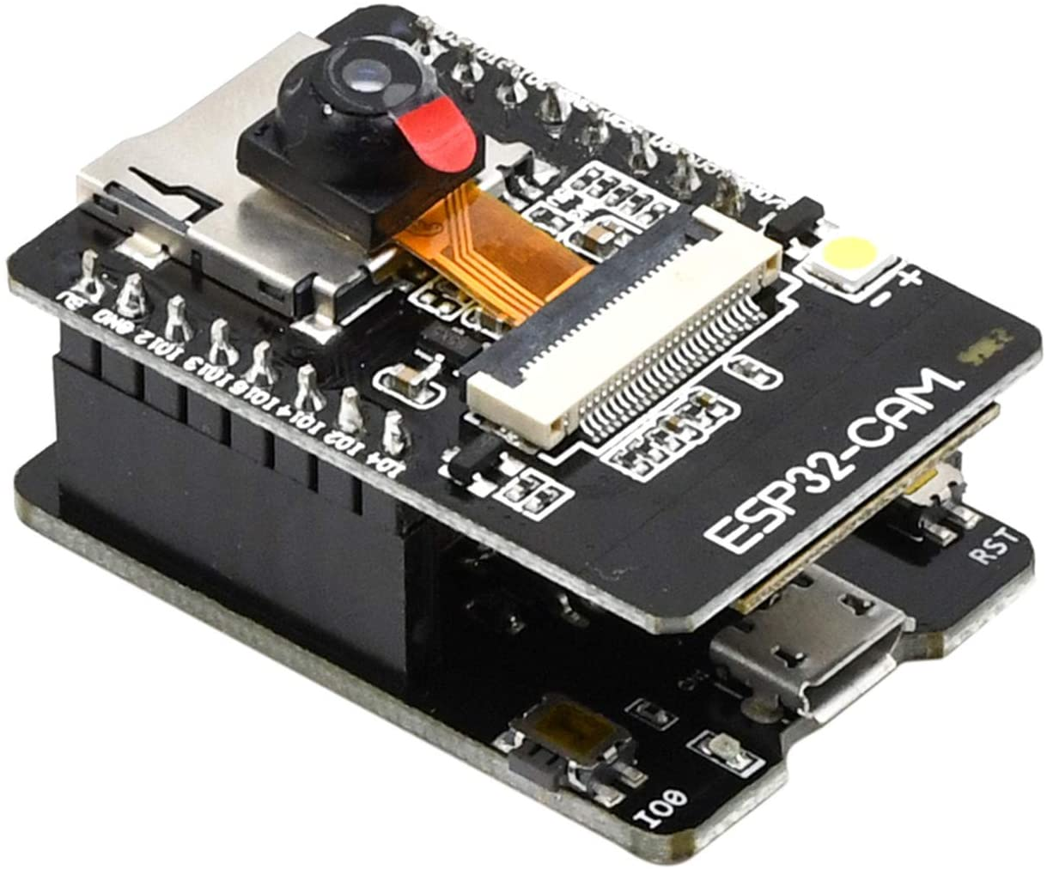
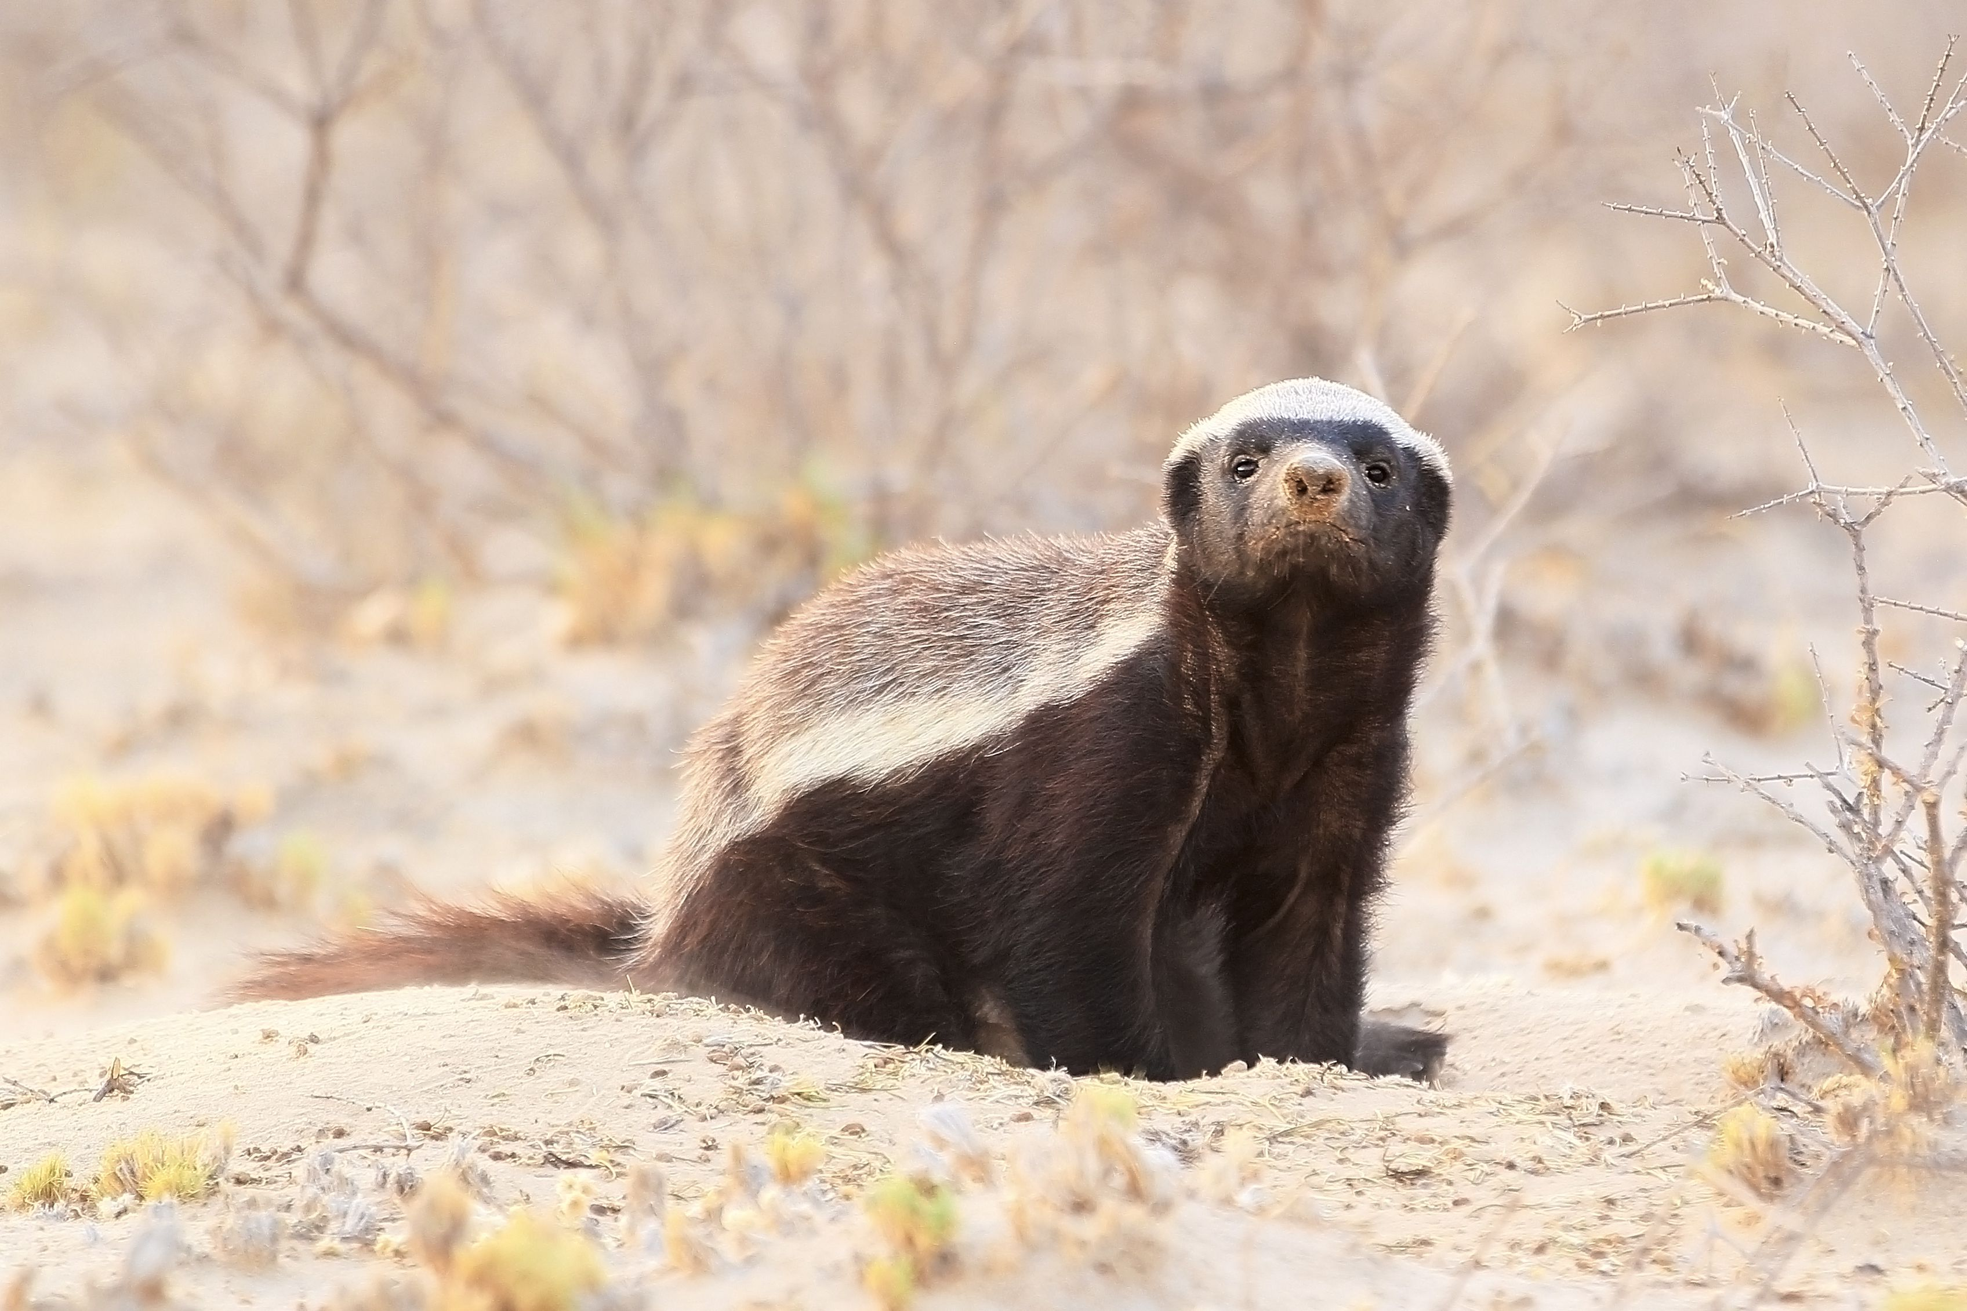

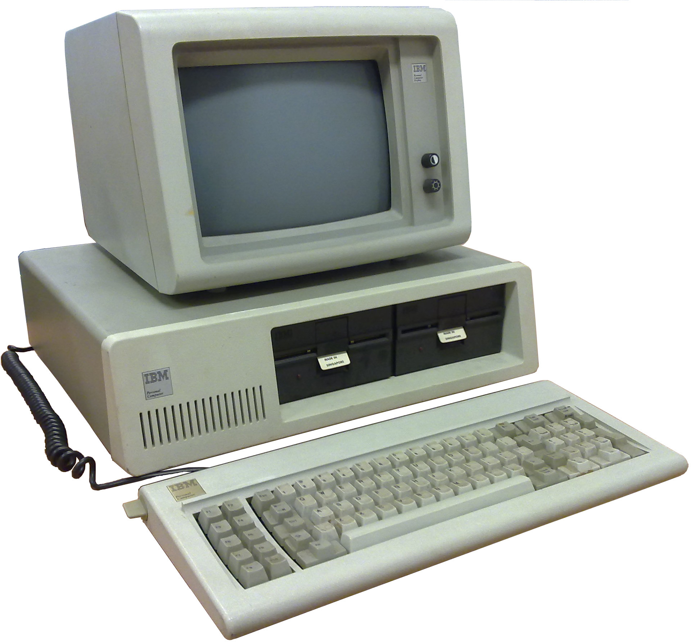

Overview
No machine learning
No database
Native web-application
UI must minimize
human error
Human is the classifier, not machine learning
Overall System Architecture

Slide 8
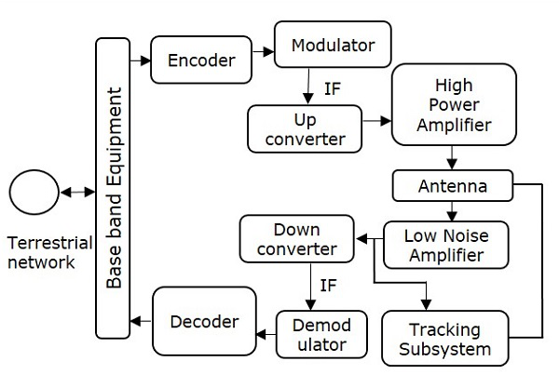
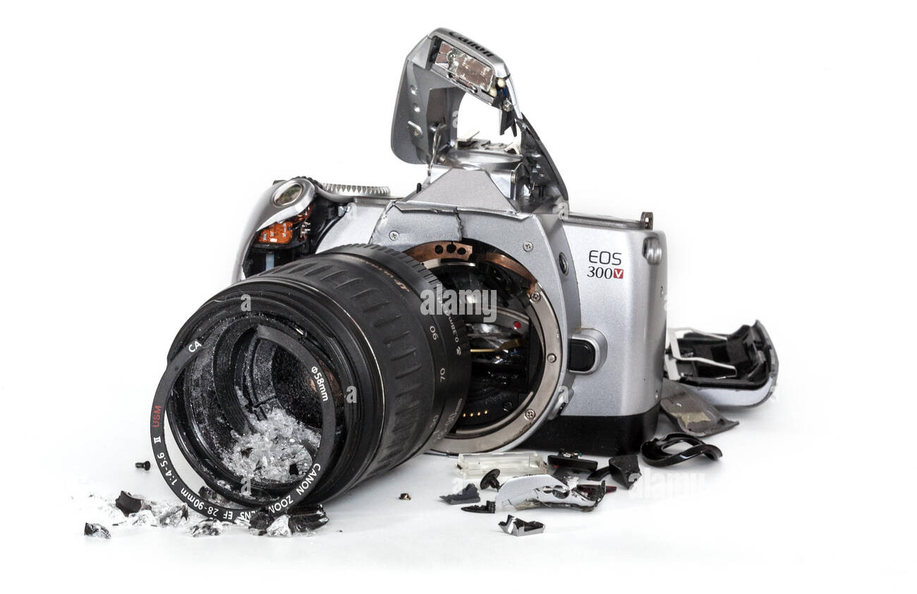
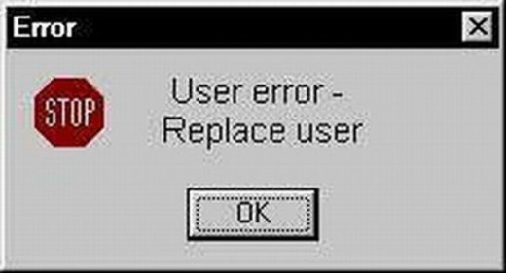
Main Goal is Reliability, Because Consequences are Severe
Drivers of Failure:
Wireless communication fails a lot
User's fail a lot, especially with bad UI
ESP32-cam suffers from frequent
camera malfunctions

Slide 9

Networking

Slide 10
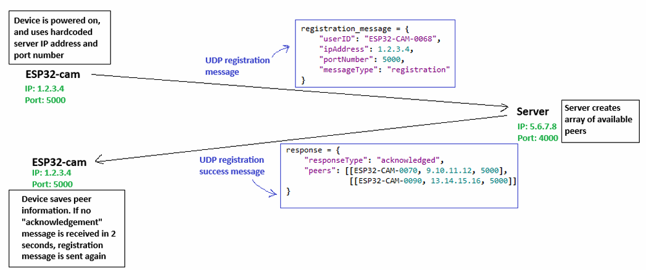
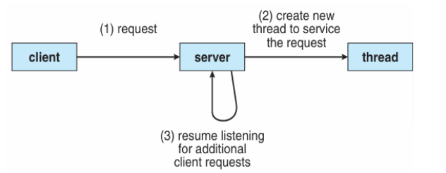
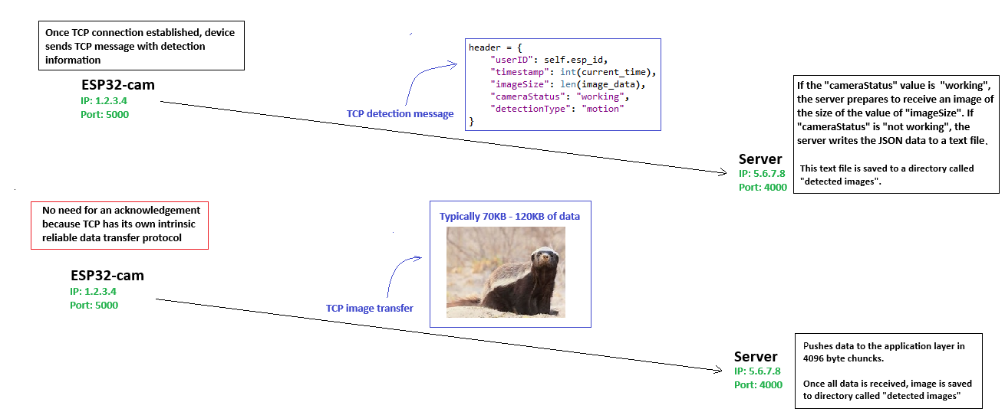
Networking Design
Application Layer Design
Correct Server Architecture
Server Architecture
Concurrency Issues
Control signals vs data signals
TCP and UDP
Message Structure and Protocol Design

Slide 11
Peer-to-peer Network
Peer-to-peer architecture
Each ESP32-cam is BOTH A SERVER AND A CLIENT in this architecture
Effectiveness scales with number of detection devices

Slide 12

User-Interface

Slide 13
User-Interface Design: Idle
User-interface in Idle Mode

Slide 14
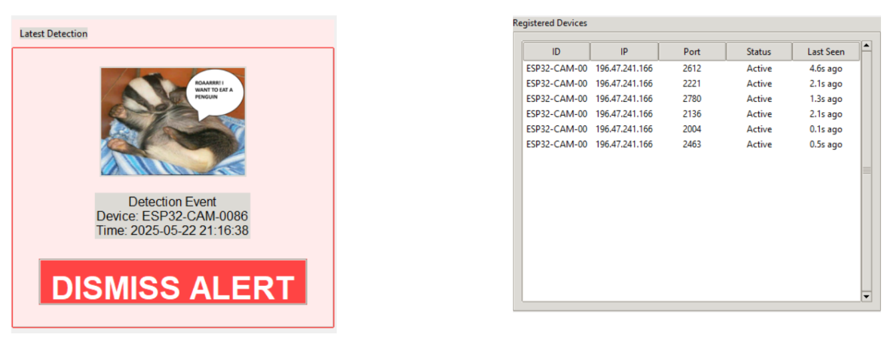
Detection Event and Registered Devices
Registered Devices
Detection Alert

Slide 15
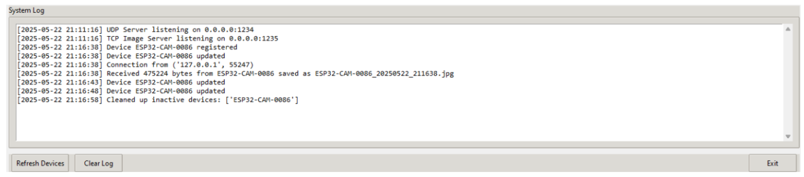
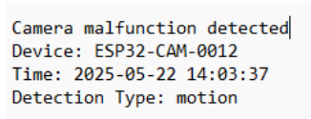
System Log and Camera Broken Handling
System Log
Data written for broken camera event, in a textfile

